Slide 1

Task Assignment
-- Jitheshwar UK

Slide 2
A lot of new users found Pormilo through Display ads followed by Organic search.
Display ads have attracted a larger amount of traffic to the website comparatively.
Paid search (SEM) was less optimal since revenue was allocated to achieve the most out of it.
Social media presence is inadequate.

Slide 3
A lot of users found Pormilo through Organic Search and made more conversions comparatively.
First-time users have shown a lot of interest through organic search.
Improving the performance of Organic Social is essential for effectively reaching potential leads and engaging with students through social media marketing.

Slide 4
Organic Social has a potentially high engagement rate but their conversions are pretty low, optimising would be the right strategy.
Organic Search has the highest engagement rate and conversions, so with good SEO it’s lucrative.
Traffic has a high engagement rate when compared to new users but their conversions are declining.
Paid Search needs to be optimised as the conversions are not in the stand with engagement rate.

Slide 5
People are more into the rewards section on the webpage, which leads to the great opportunity to conduct a reward-based marketing campaign to generate revenue. (Loyalty Campaigns)

Slide 6
Females spend a higher amount of time on website pages but their conversions are less when compared with the male. So, male customers are the target audience. 18- 24 yrs old are the ultimate target audience. Because Their conversion rates have a high probability of generating revenue.

Slide 7
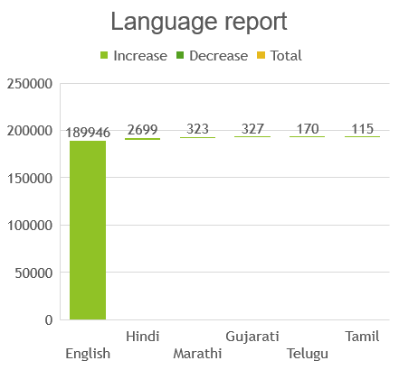
Cities with a high number of Tech companies and Universities are good places to target. Provide languages tailored to specific locations.

Slide 8
Session Google Ads campaign | Users | Sessions | Engaged sessions | Google Ads clicks | Google Ads cost | Google Ads cost per click | Conversions | Cost per conversion
App Installation for May --Shahid | 5429 | 10936 | 6276 | 147100 | 179175 | 1.218049 | 12257 | 14.61818
App Install-States-A200Inst-20Jun22 | 842 | 1655 | 968 | 28742 | 24309.13 | 0.84577 | 1794 | 13.55024
App Install-States-B100Installs-22Jun22 | 742 | 1332 | 780 | 17809 | 22374.58 | 1.256363 | 1422 | 15.73458
Marketing campaigns for app installations conducted in May experienced a surge in conversions, attributed to heightened activity among students seeking new educational opportunities, internships, and job prospects, fostering increased engagement during this period.
Overall, while "App Installation for May --Shahid" incurred the highest total cost, it also achieved the highest number of conversions at a relatively low cost per conversion, suggesting its effectiveness in driving user engagement and conversions.

Slide 9
Suggestions
Plan for aggressive social media marketing campaign.(i.e,Influencer, Sponsorships)
Improve keywords and perform SEO to top the results subsequently.
Display ads also have shown potential outcomes.
Paid Search is an underperformer.
Customer retention is inadequate.
Improve the paid search campaign by targeting the age range from 18 – 25 because they’re the target audience with high conversion rates who are most likely to avail of the company’s services.

Slide 10
Female candidates can be targeted from the 18-24 age category.
Tech cities(BLR & HYD) have seen more conversions comparatively so that we can target the cities with the high number of Tech companies in the particular city. so we can target the cities with the high number of Tech companies and universities in the particular city.
Website can be optimised to specific languages through demographic factors targeting indigenous people with language barriers.
Initially, to expand into the international market, the USA is a potential.
Paid marketing campaigns often benefit from strategic scheduling aligned with calendar time(May) to effectively reach target objectives.

